Slide 1
The following are slide excerpts from a presentation to a state hospital association CEO committee by a hospital food service director

Slide 2
THE FOOD-HEALTH CONNECTION
#1 Healthy eating is an integral part of overall health.
#2 The food system is a major economic generator that creates opportunities to lift rural communities out of poverty.
#3 The Affordable Care Act had generated new incentive to focus on prevention - a healthy food system does just that.
#4 Agricultural production practices have a direct impact on population health.

Slide 3
AFFORDABLE CARE ACT & THE FOOD SYSTEM
The ACA has a renewed focus on disease prevention which is visible through revised reimbursement rates and the community benefit standard.
Teaching patients to eat right and ensuring access to healthy food may reduce readmission for diet-related diseases.
Investing in the community food environment may help people eat better overall, improving population health, which is a primary goal of community benefits.
Notes:
When patients are readmitted within 30 days for issues like heart attack, which are closely diet related, the facility is not reimbursed, therefore it is financially beneficial to help these people eat well and stay healthy.
Community food strategies are particularly relevant for communities that face high rates of heart disease, obesity, and diabetes

Slide 4
AGRICULTURAL PRODUCTION & POPULATION HEALTH
Agricultural practices can have a significant impact on the farm workers and their surrounding communities (6).
Farm workers have three times the disability rate of the average US worker.
Use of toxic pesticides creates respiratory illness, rashes, vision problems and may be linked to cancers.
Overuse of antibiotics in animal agriculture is a major contributor to antibiotic resistance, which is having a significant impact on the health system.

Slide 5
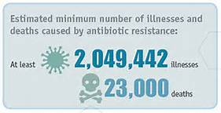
ANTIBIOTIC-RESISTANT INFECTION BY THE NUMBERS.
Antimicrobial Resistance was recognized by the World Health Organization as a global health threat in 2012.
23,000 deaths a year are attributed to anti-biotic resistant infections.
8 million additional hospital days a year due to anti-biotic resistant infection
22% of antibiotic-resistant illness in humans is linked to food.
The National Antimicrobial Resistance Monitoring System (NARMS) found antibiotic-resistant bacteria in 81% of ground turkey, 69% of pork chops, 55% of ground beef and 39% of raw chicken pieces.
Notes:
22% CDC

Slide 6
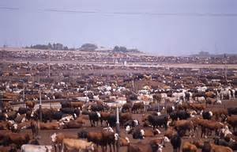
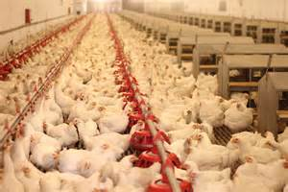
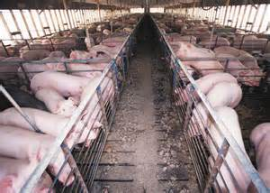
ANTIBIOTIC RESISTANT INFECTION LOOP
Colonization and Transmission of anti-biotic resistant bacteria among food producing animals.
Primary exposure from feces, intestinal flora and/or meat consumption.
Colonization and infection of individuals.
Hospital Admission and identification of colonization and infection due to drug resistance after treatment.
Transmission to community members.
Colonization of patients and
healthcare transmission.
Hospital discharge

Slide 7
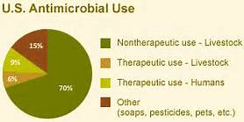
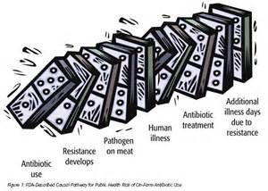
ANTIBIOTIC USE IN THE UNITED STATES
Notes:
Nontherapeutic use - In the United States, feed animals – poultry, swine, cattle and sheep – are routinely fed low doses of antibiotics through their water or food troughs to promote growth and expedite weight gain. A series of large scale studies conducted by the Department of Agriculture in 1999, 2001 and 2006 revealed that over 80 percent of swine farms, cattle feedlots and sheep farms administer antibiotics for non-therapeutic purposes (i.e., not used to treat diseases)^{i}
Therapeutic use - to treat diseases

Slide 8
THE COST OF ANTIBIOTIC-RESISTANT INFECTIONS ON POPULATION HEALTH.
Financial Cost: $20 billion in healthcare systems costs each year.
Societal Cost: Patients with anti-biotic resistant infections averaged hospital stays of 6.4 to 12.7 days longer than patients without a ARI. Resulting in a cost to US households of over $35 million due to lost wages.
Cost of Death: Death rates for patients with ARI was two fold higher than the death rate for patients without ARIs.
A 20% reduction in ARI infections would save
$3.2-5.2 billion in
healthcare costs each year.
Notes:
Tufts EDU

