Slide 1


Companion presentation for Safe haven paper
**Presentation must be tailored to your audience, especially slide pages 9, 16 & 18**
A new report produced in collaboration with PricewaterhouseCoopers Advisory Services LLC

Slide 2
How to Use this Presentation
This presentation was created to accompany, not replace Health Care Without Harm’s report, “Safe haven in the storm: Protecting lives and margins with climate-smart health care.”
Talking points are included. Full page images from the report are included to provide a taste, to inspire your audience to read it. The report’s font is often too small to read in this PPT.
Background:
Health Care Without Harm seeks to transform the health sector, without compromising patient safety or care, to be ecologically sustainable, and a leading advocate for environmental health and justice worldwide.
Practice Greenhealth is the sector’s leading membership and networking organization advancing sustainable, environmentally preferable practices: a go-to source for information, tools, resources and expert technical support.
The ‘Safe Haven’ Report was made possible thanks in part to support from the Barr Foundation, The Kresge Foundation,
MacArthur Foundation, Wallace Global Fund, and PricewaterhouseCoopers Advisory Services LLC.
Please delete this slide before presenting
Notes:
This slide should be deleted before using the presentation.
This presentation was created to accompany, not replace Health Care Without Harm’s report, “Safe haven in the storm: Protecting lives and margins with climate-smart health care.”
Note: Full page images from the report are included to provide a taste, to inspire your audience to read it.
Health Care Without Harm seeks to transform the health sector, without compromising patient safety or care, to be ecologically sustainable, and a leading advocate for environmental health and justice worldwide.
Practice Greenhealth is the sector’s leading membership and networking organization advancing sustainable, environmentally preferable practices: a go-to source for information, tools, resources and expert technical support.
The ‘Safe Haven’ Report was made possible thanks in part to support from Barr Foundation, the Kresge Foundation, the MacArthur Foundation, the Wallace Global Fund, and PricewaterhouseCoopers Advisory Services LLC

Slide 3
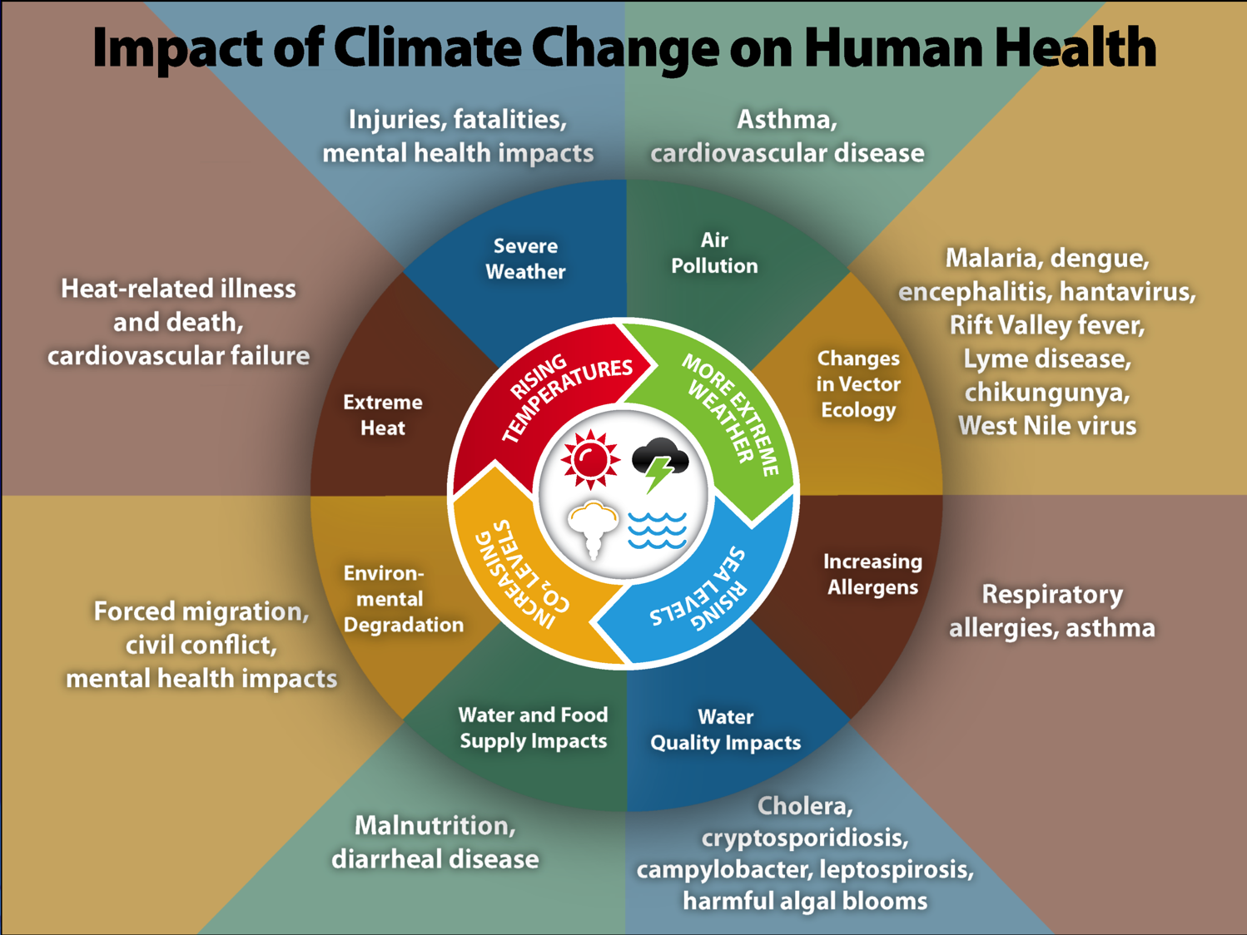
Notes:
This paper focuses on the health impacts and costs for hospitals related to extreme weather events. However, climate change influences human health and disease in numerous ways. Health effects include increased respiratory and cardiovascular disease, injuries and premature deaths related to extreme weather events, changes in the prevalence and geographical distribution of food- and water-borne illnesses and other infectious diseases, and threats to mental health (cdc.gov/climateandhealth).
Add a quote from one of your clinicians about impacts they’ve seen in their patients, stats on local health impacts, etc.

Slide 4
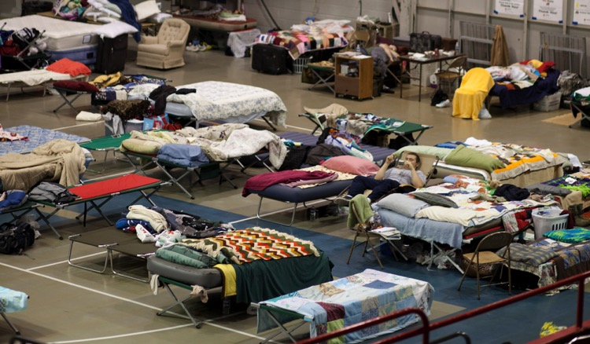

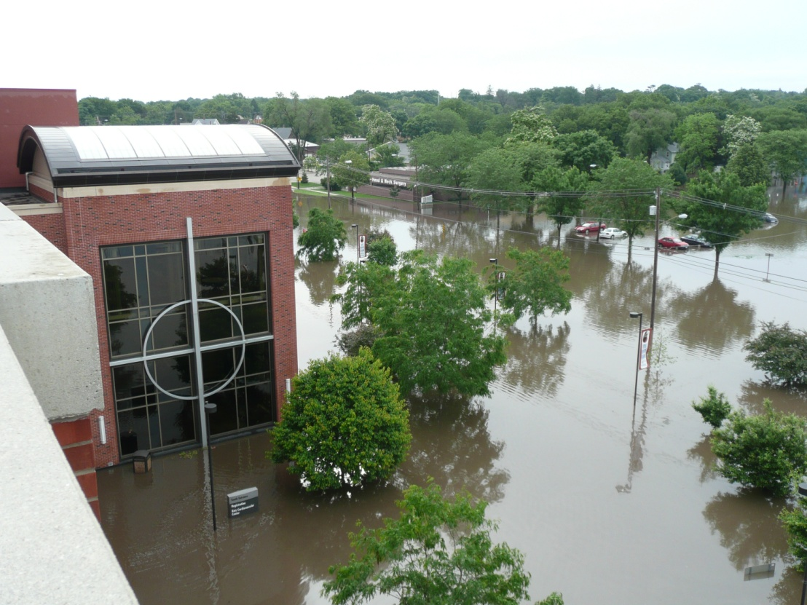
On the front lines of climate change
Mercy Medical Center, Cedar Rapids, IA, Credit Dr. Blaine Houmes / MMC
Notes:
Climate change impacts not only health, but also health care delivery.
The yearly average for U.S. extreme weather events costing over $1 billion has shot up from a historic 5.5 events in 2012 to 10.5 events in 2016. Health care has suffered billions in uncompensated losses, plus the costs of increased disease, injury, and mental health problems. 2017’s events’ costs are still being calculated, but new records will likely be set.
Hospitals need to be the last building standing but recent events demonstrate they are often more vulnerable than leaders think, and they are highly dependent on community infrastructure for continuing services.

Slide 5

Why “Safe haven in the storm?”
Until now, there has not been a hospital-focused business case to ‘connect the dots’ between climate change, health impacts, health costs, and the viability of health care systems and hospitals.
Notes:
The Lancet and many other reports have examined the health and societal cost impacts of climate change. This report brings the clinical and facility cost impacts down to a health system level, looking especially at margins.

Slide 6
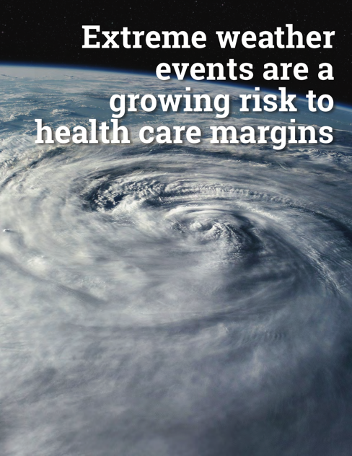
What’s in “Safe haven in the storm?”
The costs of being ill-prepared
The benefits of preparedness
How smart executives can take action:
  A four-pronged approach
  Health and Human Services (HHS) Toolkit & Hospital Preparedness Program
  Focus on policy to increase options
Notes:
Focus in impact on margin
Good data, short case studies
Four-pronged approach:
Prepare for extreme weather risks,
Reduce emissions,
Invest in community health, and
Engage in local, state and federal policy agendas.

Slide 7
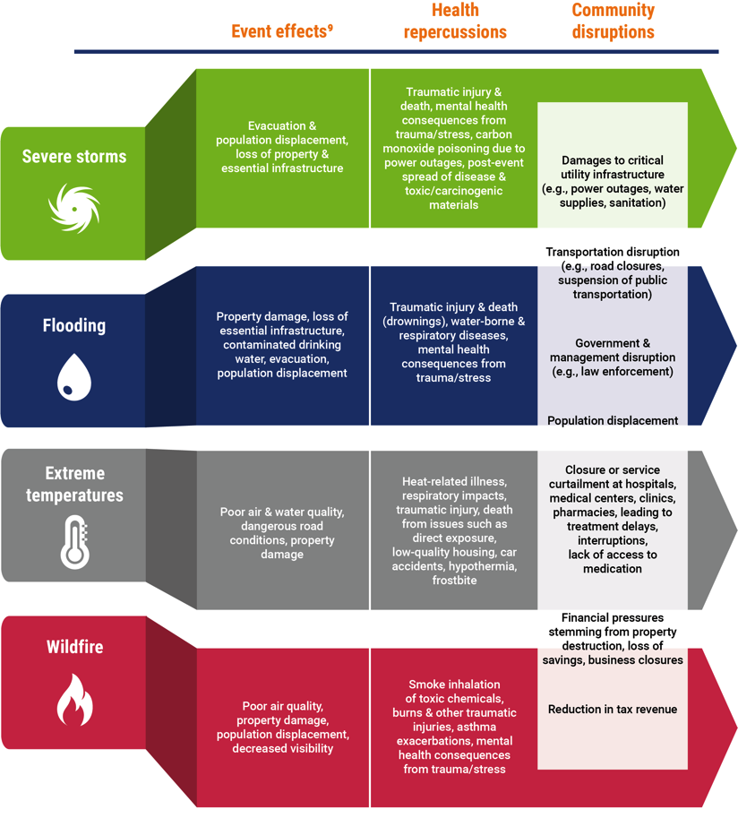
Risks of being ill-prepared
Notes:
(Report page 4)
This graphic is part of a two-page spread. It first lays out the risks of being ill-prepared for an extreme weather event and then shows the areas of cost impact.
Four categories of extreme weather events are addressed – severe storms, flooding, extreme temperatures, and wildfires. The graphic shows the effects of the event, the health consequences and the community disruption.
For instance, wildfires lead to poor air quality and population displacement, which result in asthma exacerbations and mental health consequences.

Slide 8
Costs of being ill-prepared
Notes:
(Report page 5)
This is the graphic summary of the costs of being ill-prepared for an extreme weather event. It shows the costs of disruption, and the increased costs and reduced revenue associated with an extreme weather event. All of these areas have a negative impact on margins. For instance, there are the immediate impacts on operations of closures and patient evacuations. There are increased operating costs related to staffing and power usage. And then there is the loss of revenue associated with cancelled elective appointments and treatment of uninsured and under-insured patients who are more likely to be adversely impact by the extreme weather events.

Slide 9
[HEALTH SYSTEM NAME]
Which extreme weather events might impact your hospital or health system?
Share data here about the weather changes in your geography related to extreme weather.
Share data related to costs incurred by your hospital, health system or similar systems in your region(s) related to an extreme weather event (if applicable).
Notes:
The most damaging, well-publicized, and expensive events are often storms and floods, but all regions are at risk, whether through extreme heat, wildfire, drought, or severe winter storms. 2017 events – including multiple hurricanes and wildfires – foreshadow increasing harm, fatalities, financial damage, and displaced populations.
Research shows many health care systems are not yet:
putting a 'climate lens' on their emergency preparedness and emergency medicine planning;
not tracking/accounting for the impacts in a systematic way. (How can leaders practice good risk management if they don’t have the numbers?);
assessing how government policy related to resilience, energy, water, buildings, transportation, and other infrastructure impact health systems' ability to prepare and respond;
educating and authorizing their communications and government affairs personnel to engage policy makers on such issues, even though government policy and programs have enormous influence on health care’s options for climate action. Most governmental policy-makers fail to connect the dots between climate, resilience, health impacts and health care cost containment.

Slide 10
Notes:
(Report page 10)
Two case studies are presented in the section on the “Costs of being ill-prepared:” NYU Langone’s experience in Superstorm Sandy in 2012 and the impact on Mercy Joplin from a 2011 tornado.
NYU Langone lost over $700M in research value alone.

Slide 11
Benefits of preparedness
Notes:
(Report page 15)
Effective risk management and up front investments in mitigation and climate resiliency enable smart health systems to come out on top for four reasons, all of which align with mission, public health and community resilience:
ROI - Relatively small investments in hazard mitigation measures can significantly reduce the costs incurred during an extreme weather event. The World Health Organization estimates that the price for retrofitting non-structural items can cost as little as 1% of the value of a hospital, while possibly protecting up to 90% of the hospital’s assets.
Fiduciary responsibility- In many cities and states around the country, resiliency plans are now required. The Centers for Medicare and Medicaid Services (CMS) have finalized the Emergency Preparedness Requirements for Medicare and Medicaid participating providers.
Enhanced reputation - The way a health system responds to or prepares for a crisis situation can have a major impact on its reputation. Organizations who show they were prepared for climate risks and support their communities can benefit from positive media coverage as well as more formal recognition.
Coverage stability - Communities that are more resilient to climate impacts have a more stable coverage environment. After an extreme weather event, communities that rebound quickly are more likely to retain patients with employer-sponsored insurance.

Slide 12
A lesson in preparedness:
Texas Medical Center
Hurricane Allison in 2001
→ Not prepared
Hurricane Harvey in 2017
→ Open for business
Notes:
(Report page 20-21)
2001 – Allison - Water damage to TMC’s emergency generators and electrical switchgear caused a complete power outage. Staff worked by flashlight and ventilated patients by hand as more than 1,000 patients were evacuated from TMC hospital rooms and intensive care units., TMC incurred $2 billion in research losses alone, including computer data, tissue samples and research animals.
In the aftermath of Allison, TMC member institutions united in their resolve to learn from the event and invested more than $50 million to upgrade infrastructure with resilient and sustainable design features.
2017 – Harvey - all TMC hospitals and emergency rooms stayed operational

Slide 13
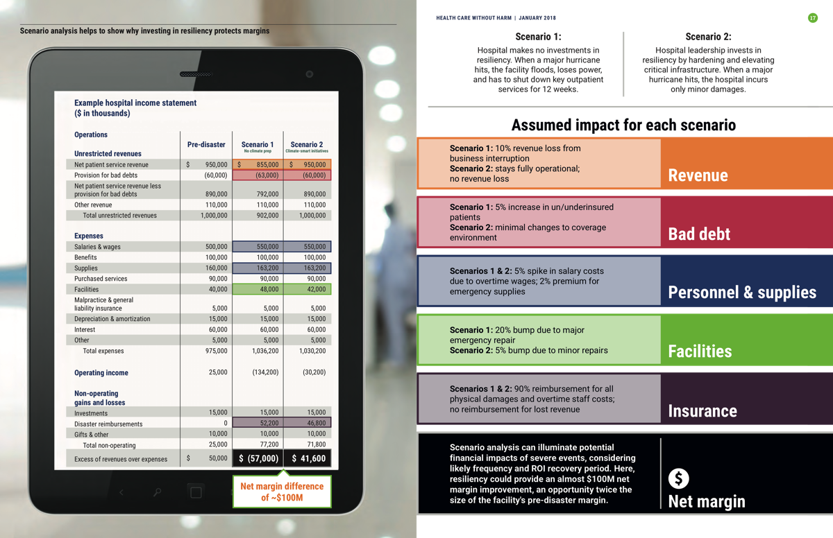
Protecting Lives and Margins
Notes:
(Report pages 16-17)
This two-page spread provides a scenario analysis of the impacts of a hurricane to show why investing in climate resiliency protects margins.
In Scenario 1, the hospital has made no investments in climate resiliency. When the hurricane hits, , the facility floods, power is lost and outpatient services are closed for 3 months.
In Scenario 2, the well-prepared hospital incurs only minor damages.
The bottom line is a net margin difference of $100M.

Slide 14
How smart executives take action
Notes:
(Report page 25)
Climate change is a critical health care and public health issue
Savvy health care leaders chase down every opportunity to strengthen and protect their operating margins. They capture the cascade of benefits that resiliency provides through four key strategies:
mitigating extreme weather risks,
reducing emissions,
investing in community health, and
engaging in local, state and federal policy agendas.

Slide 15
First Steps in Preparedness
Are climate risks included in your facility and regional emergency preparedness planning and implementation?
Have you completed vulnerability assessments for your facilities?
Notes:
(Report page 26)
Questions to engage your audience:
What is the state of our current preparedness and vulnerability assessments, and plan for upgrades?
How do we make sure we are communicating fully across our many different relevant departments impacted by climate change?
What resources are available?
Who will lead/sponsor this effort?
How are our efforts dependent on outside infrastructure and community? How do we engage our wider community to be prepared and more resilient?

Slide 16
[HEALTH SYSTEM NAME]
Current Status: share information on your:
Inclusion of climate risks into your facility and regional emergency preparedness planning.
Assessments of your campus, system, and community infrastructure vulnerabilities.
Plans and actions to increase resilience for your top vulnerabilities: e.g. buildings, energy, water, food systems, and/or most vulnerable communities.
Efforts to address changes in clinical demand related to extreme events.
Mitigation of impacts on financials/margin.
Notes:
Link each item to:
any cost savings
risk management aspects
your institutional mission
existing strategic priorities

Slide 17
Best practices for climate-smart policy advocacy
Track climate-related costs in clinical and facility operations, while actively seeking new climate, energy and resilience funding streams.
Use cost data and health system expertise to collaborate with regional energy NGOs to assess policy risks and opportunities.
Use data from items 1. and 2. above to educate and activate health care government affairs staff so they can engage on climate and energy issues.
Add climate, energy, and resilience to hospital association and medical society agendas to increase leverage and lower engagement risks and costs.
Participate in national efforts such as the Health Care Climate Council and Medical Society Consortium on Climate and Health
  https://noharm-uscanada.org/healthcareclimatecouncil
  https://medsocietiesforclimatehealth.org/.
Notes:
It is impossible to overstate the extent to which public policy can limit or facilitate a health system‘s climate-smart options. Federal, regional, state, and municipal actions largely determine what changes can be made to institutional and community infrastructure, e.g. public utility departments, energy grid rules, and market structures all impact energy options.

Slide 18
[HEALTH SYSTEM NAME]
What work is being planned, or that you would like to do in the four action categories:
Investments in resilience to mitigate climate risk.
GHG emissions reduction.
Investments in community health.
Policy engagement.
Notes:
This is your time to shine or leverage this paper to make some asks. Depending on your audience and your current needs, asks may range from seeking leadership/board of trustee sponsorship of making climate resilience a priority, to funding HHS Toolkit vulnerability assessments for your facilities, to having your Green Team include a member from Emergency Preparedness.
Ask again:
What resources are available, or could be found?
Who will lead/sponsor this effort?
Which departments will contribute/be involved?

Slide 19
Want to learn more?
“Safe haven in the storm: Protecting lives and margins with climate-smart health care”
  https://noharm-uscanada.org/safehaven
Health Care Without Harm
  https://noharm-uscanada.org/
Practice Greenhealth
  https://practicegreenhealth.org/
  Health Care Climate Council
  https://noharm-uscanada.org/healthcareclimatecouncil
“Resilience 2.0: Healthcare’s Role in Anchoring Community Health and Resilience”
  https://noharm-uscanada.org/Boston
Optional: add key internal, regional or local resources
Notes:
Optional: add any key regional or local resources

Slide 20
Notes:
If you have used this slide deck and would be interested in sharing information to help build the wider business case, please share your customized slides with Health Care Without Harm.
We will only use data anonymously or in aggregate unless you indicate that you are interested in being featured as a case study.

Slide 21
Building the Business Case for the Sector
If you have used this slide deck and would be interested in sharing information to help continually strengthen the business case for climate action, please share your customized slides and/or relevant financial information or analysis with Health Care Without Harm (see slide above for contact information).
We will only use data anonymously or in aggregate unless you indicate that you are interested in being featured as a case study.

